Slide 1


L3 Technologies
Multi-Robot SLAM
Roger Kleinmann, Christina Maher,
Kelly Munyan, Max Panoff

Slide 2
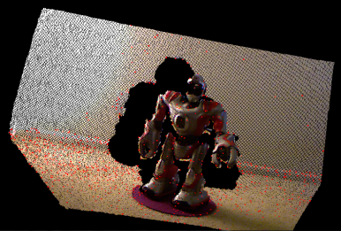
Background - Sensors
Lidar
Uses light to determine ranges
at different angles
Uses this to build a model of
surroundings
Depth Camera
Builds a point cloud
Color of each point as well
(6)
Notes:
Max
Explain in less than 5 slides any technical, social or other background necessary for a person to understand your project
–
Explain any terminology or acronyms used.
Slide 1: Sensors?
Slide 2: Slam?
Slide 3: Machine Learning?
Slide 4: Previous Devices?

Slide 3
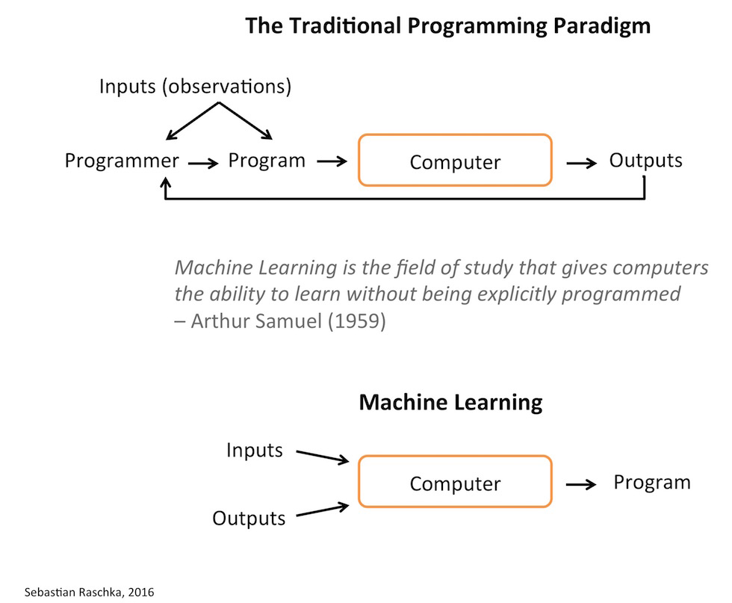
Background - Machine Learning
Pattern identification
No human input
Increased efficiency
Used in numerous applications
Face recognition
Autonomous cars
(4)
Notes:
Raschka, Sebastian. “Machine Learning FAQ.” Sebastian Raschka's Website, Sebastian Raschka, sebastianraschka.com/faq/docs/datascience-ml.html.

Slide 4
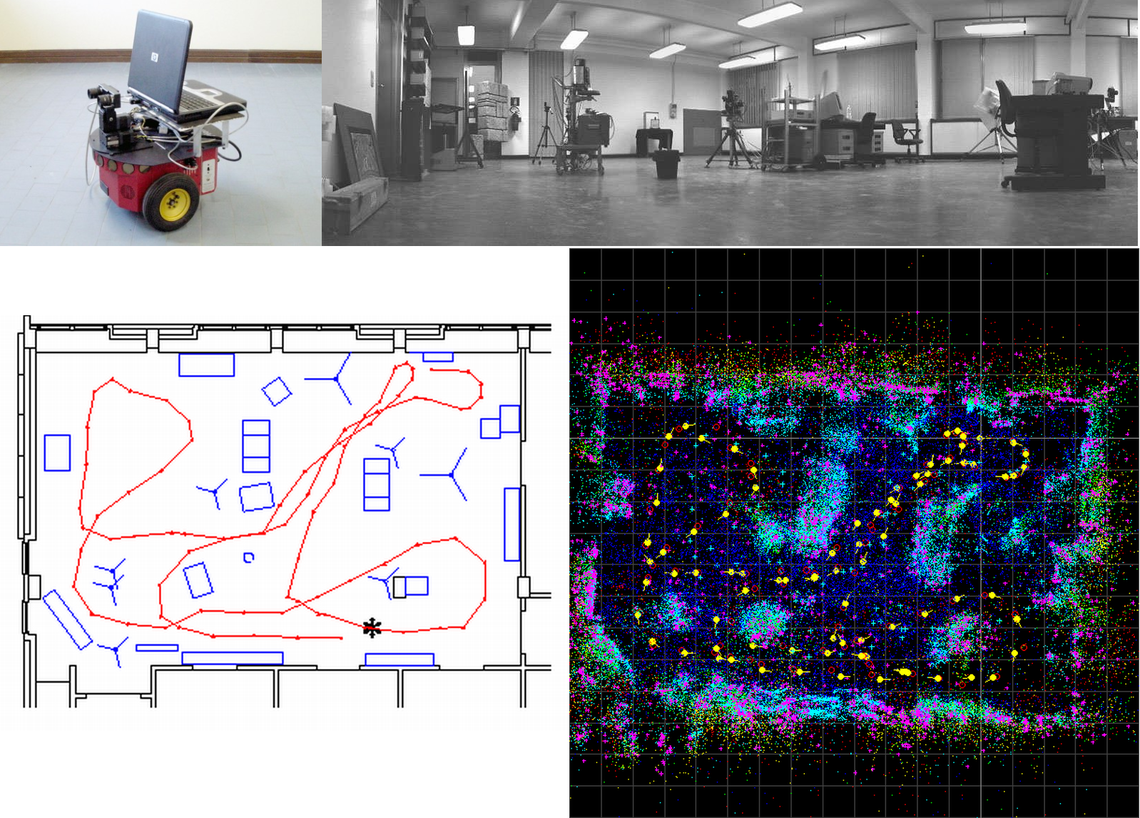
Background - SLAM
Simultaneous Localization and Mapping
Creates highly accurate maps
Based only on local sensor data
Coordinate based for easy syncing
(5)
Notes:
Simultaneous Localization and Mapping (SLAM).” INIRM, INIRM, 2005, oldsite.inrim.it/ar2005/ar/va_slam_full.png.

Slide 5
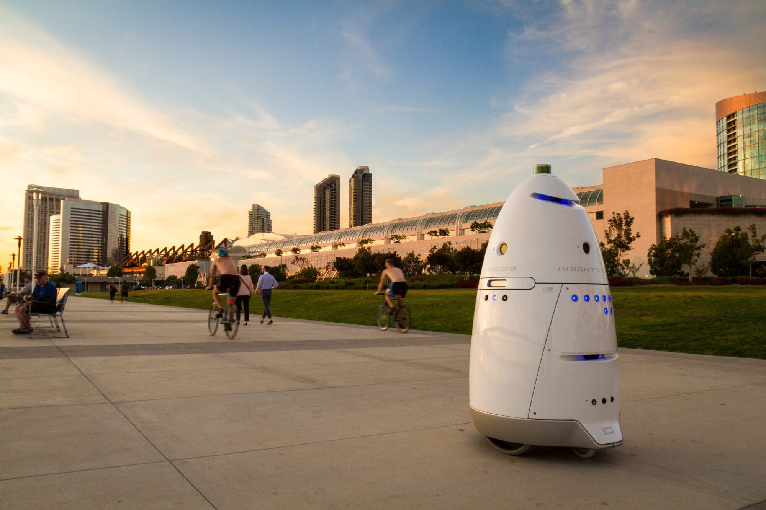
Background - Current State of the Art
FAST System, very detailed
Lidar usage
KnightScope a multiple
robot system specializing in
security
(10)

Slide 6
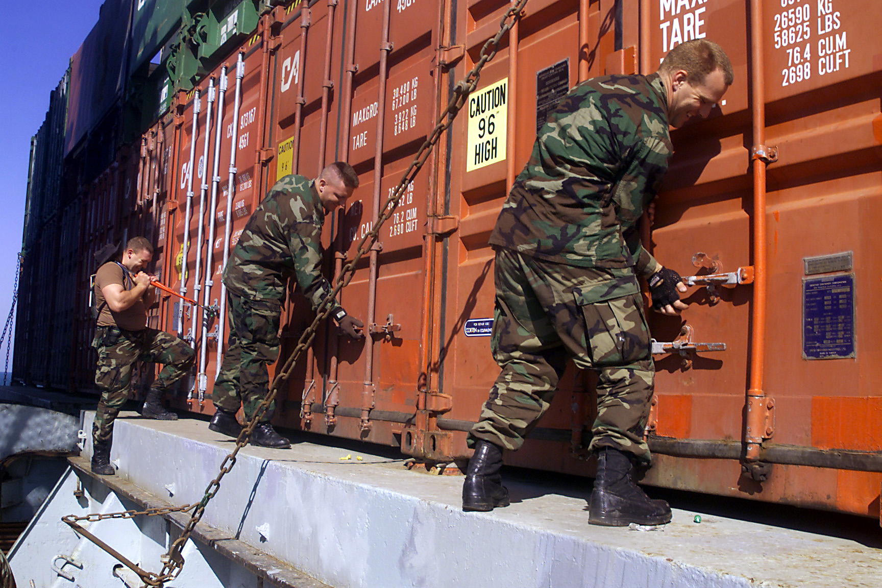
Problem Description
As of present, several human resources are necessary for the inspection of naval vessels
Several possible solutions exist but several have downfalls such as:
A single robot system requires:
More time for inspection
A human operator
A multiple teleoperated system requires:
Multiple human operators
Eliminates purpose of system
(9)
Notes:
Christina

Slide 7
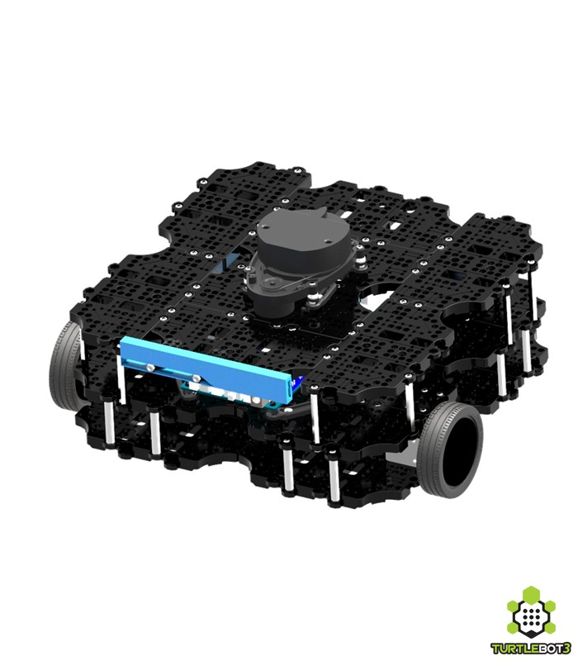
Project Scope
Autonomous Multi-Robot System capable of:
Integrating 3 individual robots to work as one system
Merging 2D LiDAR maps of ship environment
Identifying and classifying objects of interest
User input
Machine Learning
Using 3D depth camera for higher quality images
Storing and sending data to remote user
Beginning Phase of Multi-Year Project
(2)
Notes:
Christina

Slide 8

Stakeholders and Perspective
Stakeholders:
L3 Technologies Communication Systems-East
Users
Students and Staff of ME 423-X2
Future Senior Design Groups
Production Staff
Maintenance and Service Staff
Legal Department
Notes:
Kelly

Slide 9
Primary Needs and Intent
Primary Needs:
Monitor and inspect the internal areas of a ship
Autonomously generate a 2D map of its environment and send to the human operator
Communicate & merge data with multiple robots within the network
Detect objects of interest and avoid obstacles
Communicate with human operator
Operate safely
Marketable & profitable
Notes:
Kelly

Slide 10
Design System Requirements - Functional
ID | Requirement | Imp.
SYS1.1 | The system shall be able to autonomously generate a 2D map of its environment. | 3
SYS1.2 | The system shall be capable of detecting objects of interest. | 2
SYS1.3 | The system shall be able to monitor and inspect the internal areas of a ship. | 1
SYS1.4 | The system shall be able to alert a human operator. | 2
SYS1.5 | The system shall be composed of a network of robots. | 3
SYS1.5.1 | The system shall allow the robots to communicate together to merge the individual maps to a single, consistent, accurate map. | 3
SYS1.5.2 | The system shall allow each individual robot to recognize other robots and adjust the path accordingly. | 3
SYS1.6 | The system shall recognize critical regions of the environment. | 1
SYS1.7 | The system shall be able to autonomously avoid all obstacles. | 2
SYS1.8 | The system shall allow for a human override for task selection. | 1
SYS1.9 | The system shall allow for use of software and hardware integrated together. | 3
The system should reduce the crew needed to inspect an area
2D map sent and stored to human operator
Cognizant of environment - identify objects of interest, avoid collisions
Notes:
Christina

Slide 11
Design System Requirements - Non-Functional
ID | Requirement | Imp.
SYS2.1 | The system shall be safe for human operators and humans in the environment. | 3
SYS2.1.1 | The system shall not have a physical impact on the layout of the operating environment. | 2
SYS2.1.2 | The system shall have sounds levels less than 80dB. | 1
SYS2.2 | The system shall be useable in a large operating environment with discrete areas. | 1
SYS2.3 | The system shall provide map information to the human operator. | 3
The system should be user friendly by being both safe and easy to operate
Provide information directly to the human operator
Safe for contact with humans and the environment

Slide 12
Design Hardware Requirements - Functional
ID | Requirement | Imp.
HDW3.1 | The hardware shall be able to process data from multiple high demand sensor devices | 3
HDW3.2 | The hardware shall be able to sense objects from distances of at least 2m | 2
HDW3.3 | The hardware shall have a mobile power supply | 3
HDW3.4 | The hardware shall relay information wirelessly to other detached hardware components | 2
HDW3.5 | The hardware shall have a means of recording image data | 3
Some platforms are designed only for a LiDAR OR a 3D depth camera but not both
2D LiDAR will be used mostly for SLAM
3D depth camera will be used for object recognition
Image data is integral to object identification
Machine learning relies on image features
Notes:
Roger

Slide 13
Design Hardware Requirements - Nonfunctional
ID | Requirement | Imp.
HDW4.1 | The hardware shall be able to travel at a top speed of at least 20 cm/s | 2
HDW4.2 | The hardware shall be able to run continuously for at least 1 hour | 3
HDW4.3 | The hardware shall be no more than 40cm in length in any direction | 1
HDW4.4 | The hardware shall be modifiable for later addition of additional sensors and beacons | 2
HDW4.5 | The hardware shall have the capacity to be used with a variety of navigation strategies in case pivoting is necessary | 1
One hour of operation at 20 cm/s equates to 720m of travel per robot
Able to pace a 30m long room 24 times
Modifications would allow for aftermarket sensors and beacons
Assists in robot identification and merging of 2D maps

Slide 14
Design Software Requirements - Functional
ID | Requirement | Imp.
SFW5.1 | The software shall gather data from its surroundings at a sufficiently high rate | 3
SFW5.1.1 | The software shall gather 2D LiDAR data at a rate of at least 10Hz | 2
SFW5.1.2 | The software shall gather data from the camera at a rate of at least 30 Hz | 1
SFW5.2 | The software shall be able to create, support, and modify a map of the System’s surroundings | 3
SFW5.2.1 | The Software shall be able to integrate 2D LiDAR data into this map | 2
SFW5.2.2 | The Software shall be able to integrate data from a point cloud into this map | 2
The software must support appropriate refresh rates
This prevents aliasing
Also ensures that model quickly changes to changes in environment, including robot movement
Simply collecting data is insufficient, the software must allow:
Real time modification the map, from multiple sources
Visualization of the map
Indicate areas of interest on the map
Notes:
Max

Slide 15
Design Software Requirements - Functional
ID | Requirement | Imp.
SFW5.3 | The Software shall allow communication between different instances and users | 3
SFW5.4 | The software shall be able to identify a wide variety of objects and alert a user if one shows up on the camera | 3
SFW5.5 | The software shall support a Graphical User Interface which displays the current map and allows user interaction | 1
This system should also allow users to see what each of its members see:
The lidar data from each robot,
Remote viewing of the camera
The system should also be able to use the depth camera to detect objects
For this project it will be under stable moderate lighting
Use existing libraries to train
Notes:
Max

Slide 16
Design Software Requirements - Non Functional
ID | Requirement | Imp.
SFW6.1 | The Software shall be capable of emergency shutdown from a user | 2
SFW6.2 | The software shall have basic security, a password to access the network the platforms are on | 3
SFW6.3 | The code shall be well documented | 1
This system will make use of a local network
Password to connect, ensures only authorized access
Notes:
Max

Slide 17
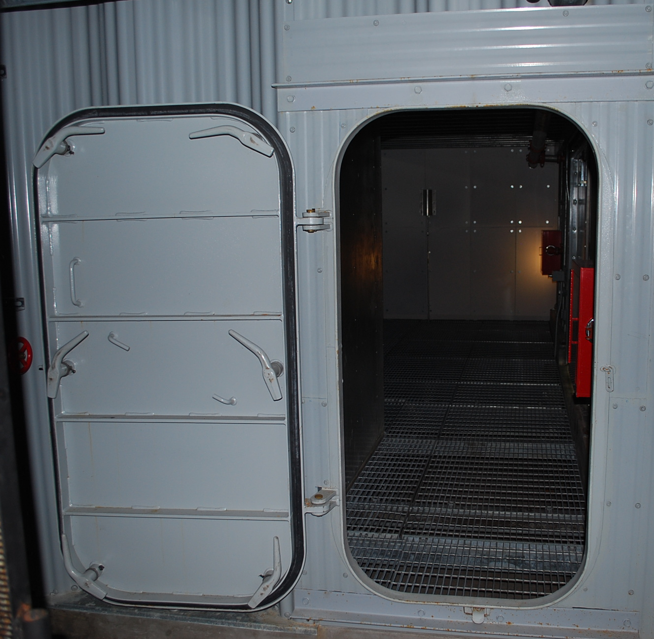
Assumptions
Assumptions and Support Systems:
Any ship
Initial design to be used on level ground
Alpha and beta prototypes not expected to surpass boundary of doorway
Robots communicate using routers on individual robots in absence of wireless connection
Mapping achieved by 2D LiDAR and/or 3D depth cameras
At least one human operator will monitor the system
(8)
Notes:
Kelly

Slide 18
Constraints
Constraints:
Cost: $5,000+
Size: shorter than 40cm in any direction
Weight: < 3 kg
Processing Power: GPU with CUDA compute 3.0
Battery Life: at least 1 hour
Timeline: ~7 months
Notes:
Kelly
Processing power- tensorflow requirement

Slide 19
Concept Development - Considerations
Cost is a limiting factor regarding number of robots
Most platforms cost $500-$2,500
More expensive models immediately not considered
Platforms with immediate SLAM capabilities
SLAM and machine learning require extensive development time
Must be up and running fast
Processing capacity drastically limits performance
HLS-LFCD2 samples at 1.8kHz
Intel Realsense R200 from 30FPS & 320x240 up to 60FPS & 480x360
Platforms should be flexible to multiple navigation strategies
Notes:
Roger

Slide 20
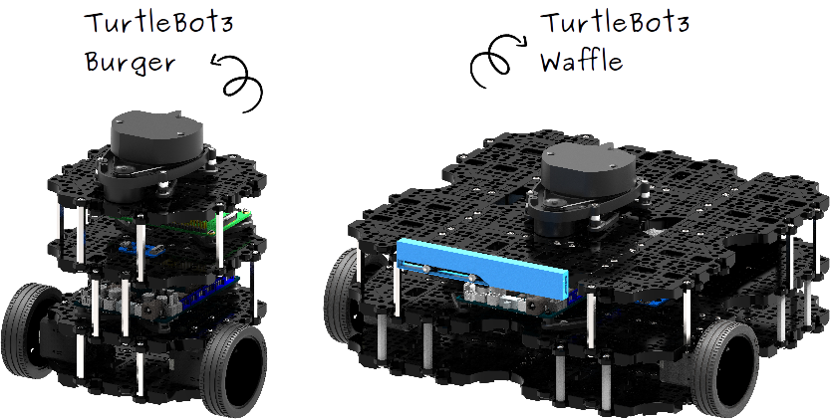
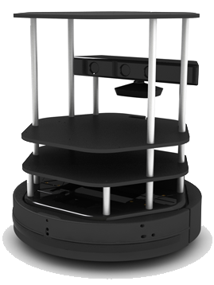
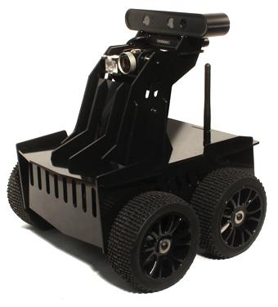
Concept Development - Platforms
(2)
Turtlebot 3 Waffle
$1,800
2D LiDAR & depth camera
Turtlebot 3 Burger
$550
2D LiDAR
Turtlebot 2e
$1,900
Depth camera & high capacity for modification
Oculus prime
$1,400
Depth camera & high mobility
(1)
(3)
Notes:
Roger

Slide 21
Concept Selection
 |  | Concepts
 |  | Waffle (TurtleBot 3) |  | Burger (TurtleBot 3) |  | TurtleBot 2e |  | Oculus Prime
Selection Criteria | Weight | Rating | Weighted Score | Rating | Weighted Score | Rating | Weighted Score | Rating | Weighted Score
Cost/quantity available | 20% | 3 | 0.6 | 8 | 1.6 | 2 | 0.4 | 5 | 1
Processing Capability | 20% | 9 | 1.8 | 4 | 0.8 | 6 | 1.2 | 7 | 1.4
Mobility | 15% | 6 | 0.9 | 5 | 0.75 | 5 | 0.75 | 7 | 1.05
Capacity for Modification | 10% | 9 | 0.9 | 7 | 0.7 | 9 | 0.9 | 1 | 0.1
Sensors Provided | 15% | 8 | 1.2 | 5 | 0.75 | 4 | 0.6 | 5 | 0.75
Portability | 5% | 7 | 0.35 | 8 | 0.4 | 5 | 0.25 | 3 | 0.15
Sensor Accuracy | 15% | 8 | 1.2 | 7 | 1.05 | 6 | 0.9 | 6 | 0.9
Total Score |  | 6.95 |  | 6.05 |  | 5 |  | 5.35
Rank |  | 1 |  | 2 |  | 4 |  | 3
Status |  | Develop |  | Reject |  | Reject |  | Reject
Notes:
Roger

Slide 22
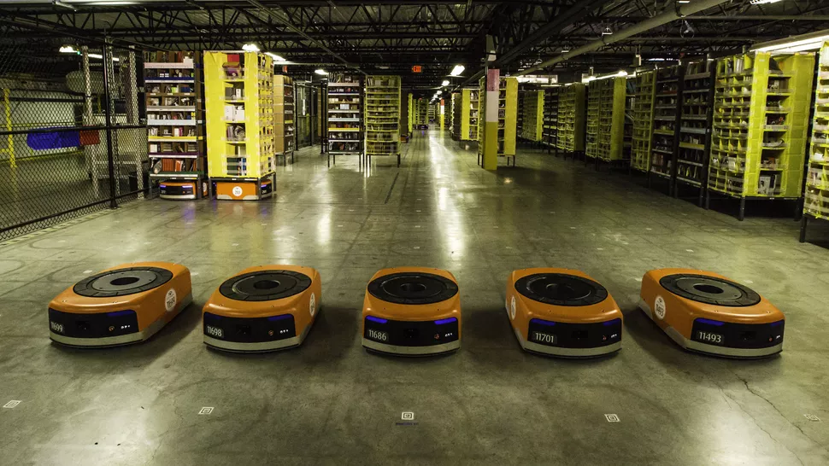
Strategy Considerations
Level of manual control to be implemented
How the system should be initialized
Level of environmental instrumentation
Sensing modes for localization
Centralized or decentralized decision making
Robot hierarchy
(7)
Notes:
Roger

Slide 23
Resources
http://www.turtlebot.com/turtlebot2/
http://turtlebot3.robotis.com/en/latest/
http://www.xaxxon.com/
https://sebastianraschka.com/faq/docs/datascience-ml.html (broken link)
http://oldsite.inrim.it/ar2005/ar/va_slam_full.png (broken link)
https://azerdark.wordpress.com/category/point-cloud/
https://www.cnet.com/news/meet-amazons-busiest-employee-the-kiva-robot/
https://www.fireblast.com/maritime-fire-training/
http://archive.defense.gov/photos/newsphoto.aspx?newsphotoid=3225
http://www.knightscope.com/gallery/#&gid=1&pid=10

Slide 24
Questions?

